Slide 1
Capstone Project 4
By : Jing Wen

Slide 2
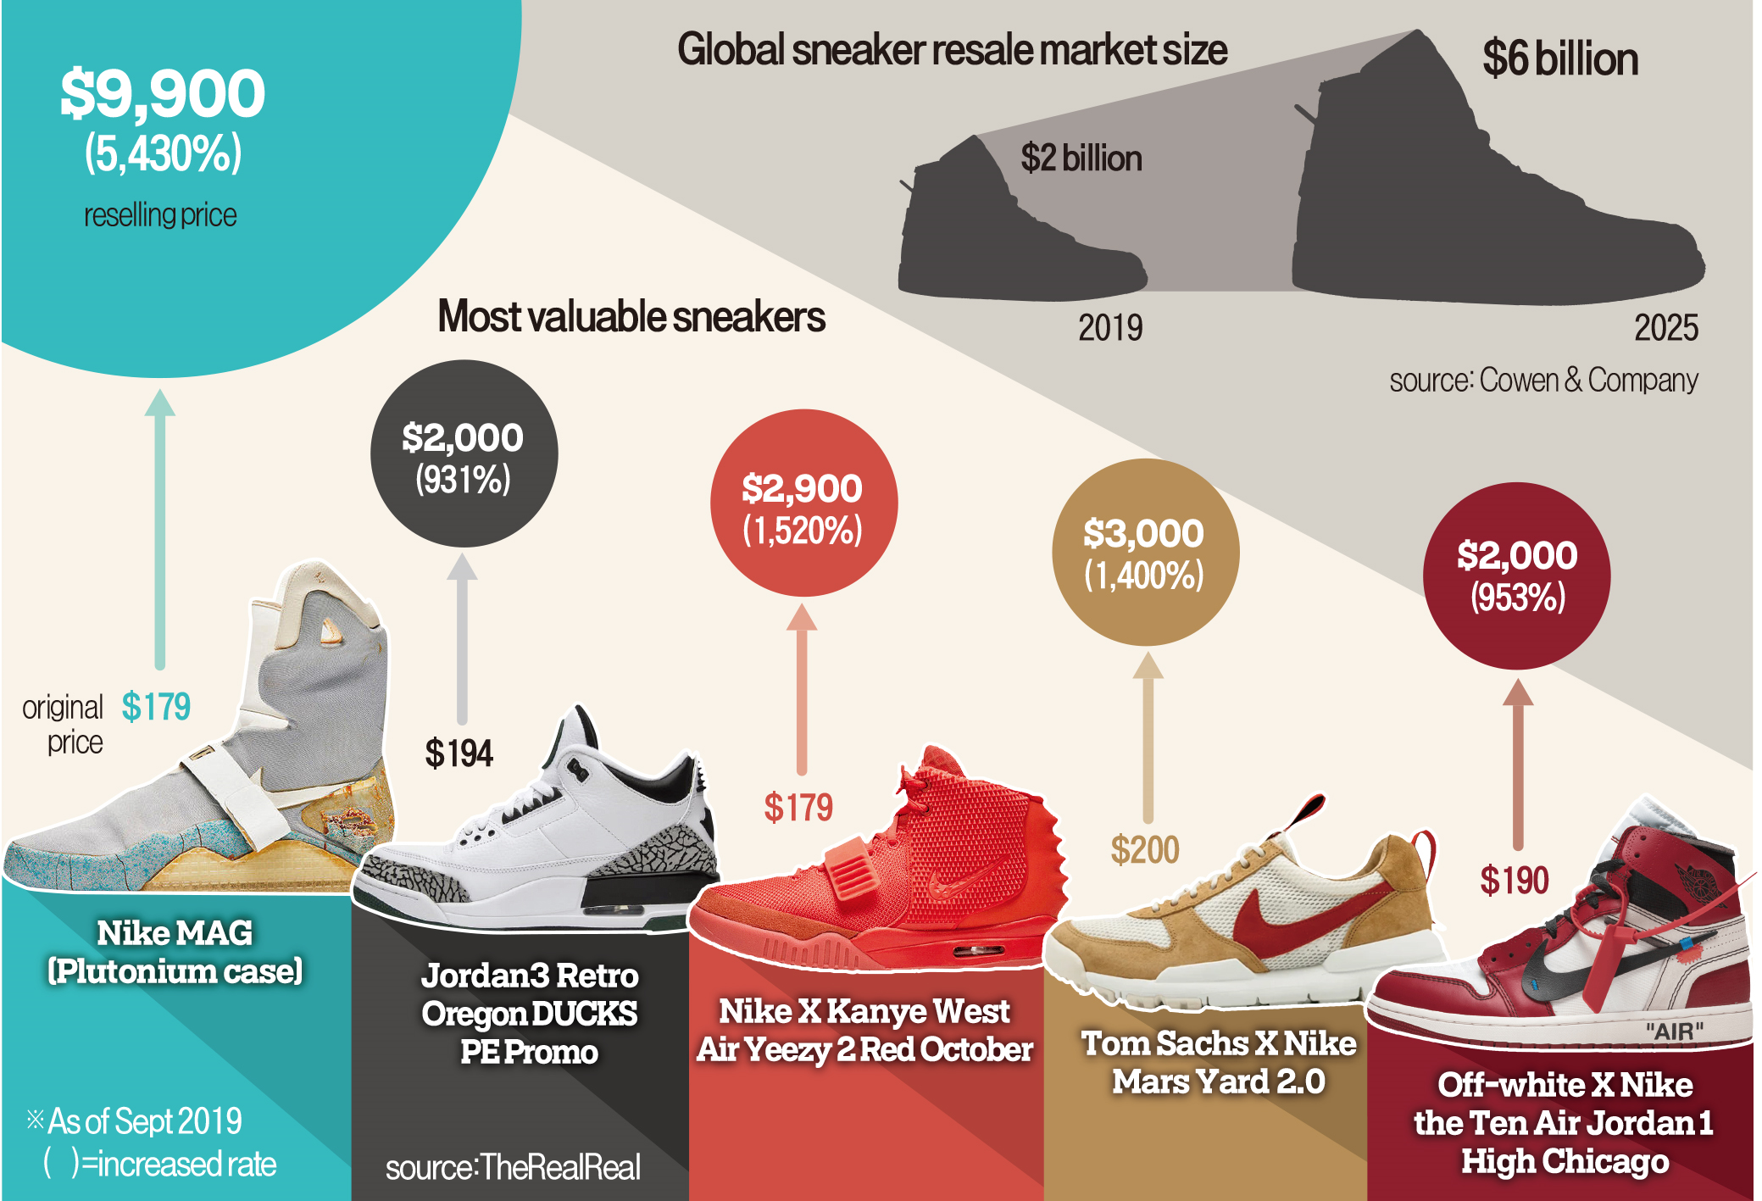
Introduction
Want to try a side hustle of reselling sneakers for profit
Used previous data from capstone 3
Original data from kaggle

Slide 3
Objectives
1. To see some of the factors of shoes that we think might affect the price
2. Using machine learning models, see if they are able to predict the prices by training them
3. See which model is most suitable (has the highest score) to use for our sneakers reselling

Slide 4
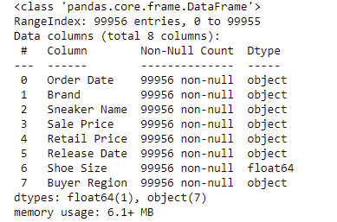
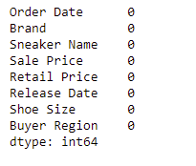
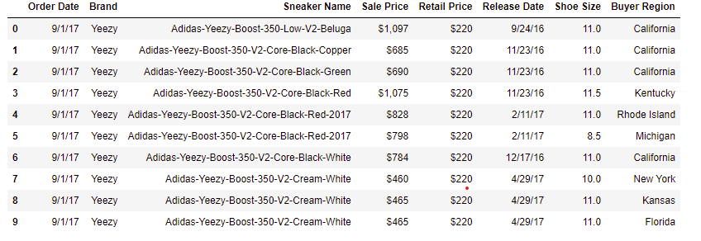
Feature Engineering

Slide 5
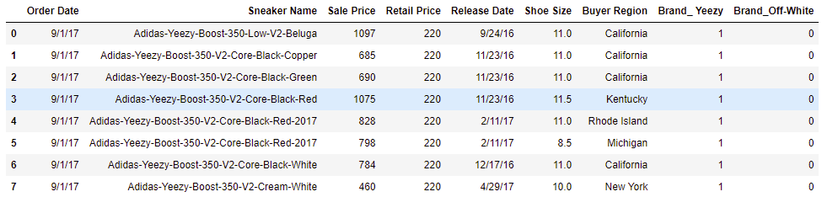
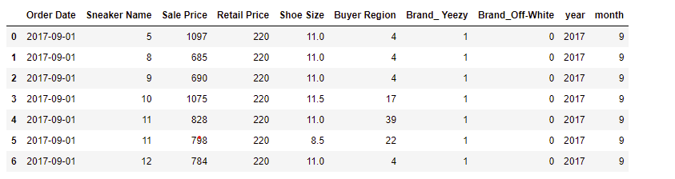
Feature Engineering

Slide 6
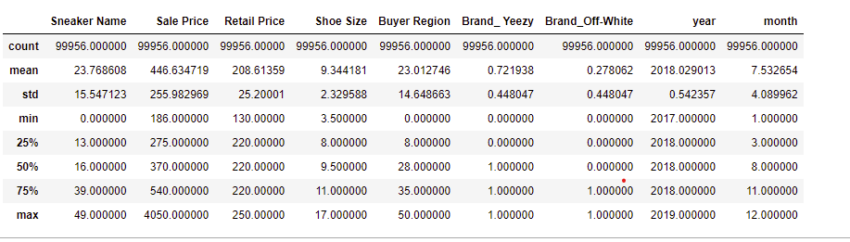
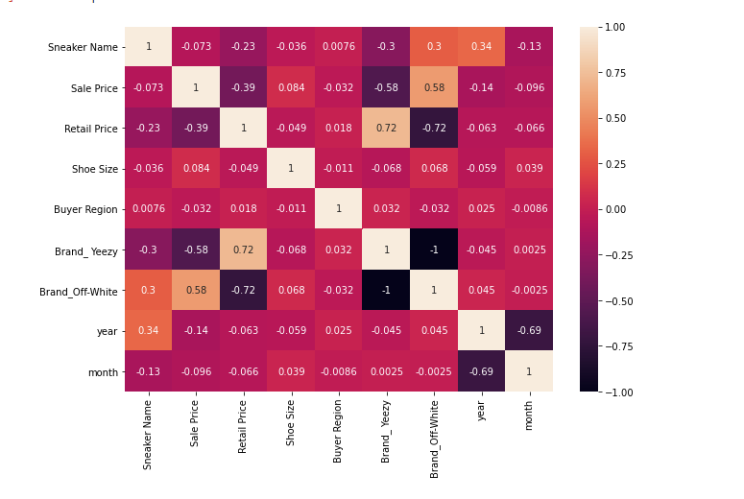
Feature Engineering

Slide 7
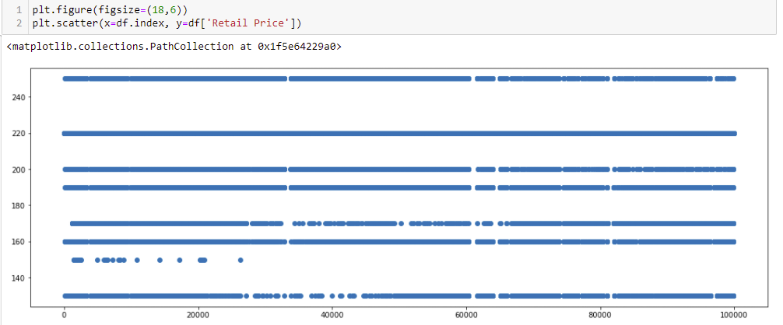
EDA
Retail price scatter plot

Slide 8
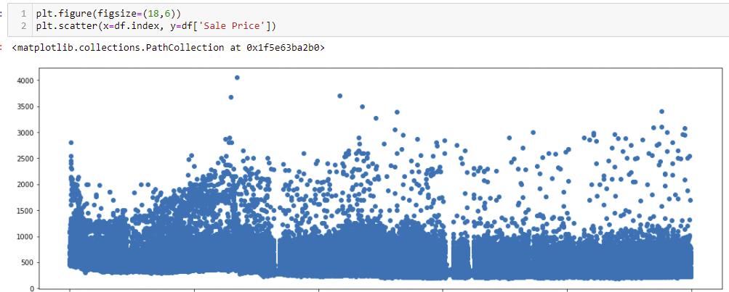
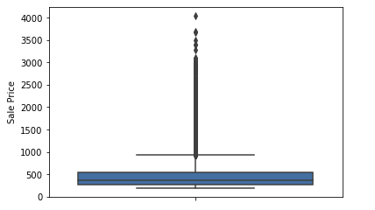
EDA
Resale price scatter plot

Slide 9
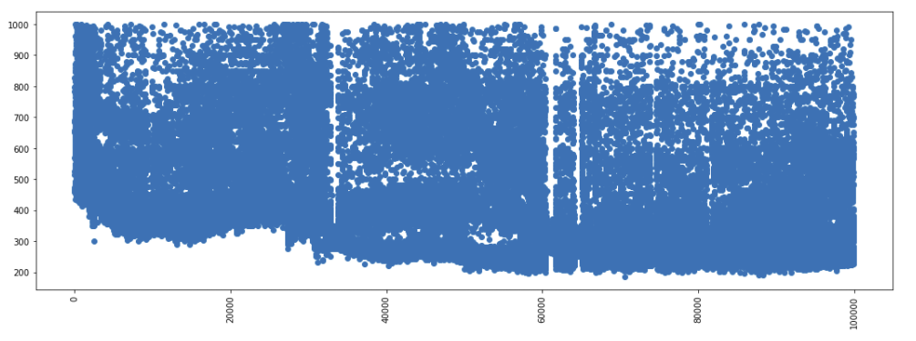
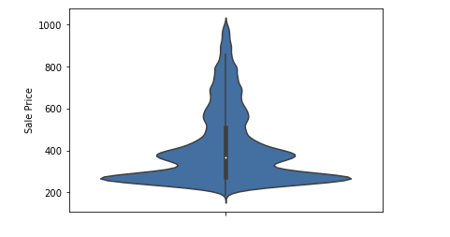
EDA
After removing rows where resale price is > 1000

Slide 10
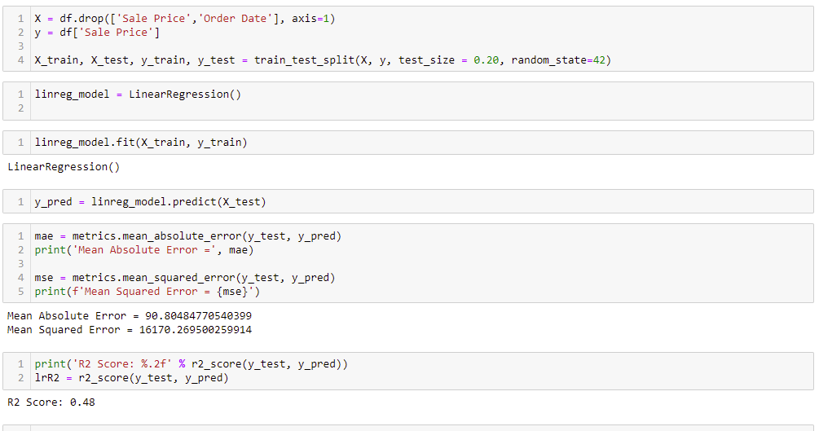
Build Machine learning models(Linear Regression)

Slide 11
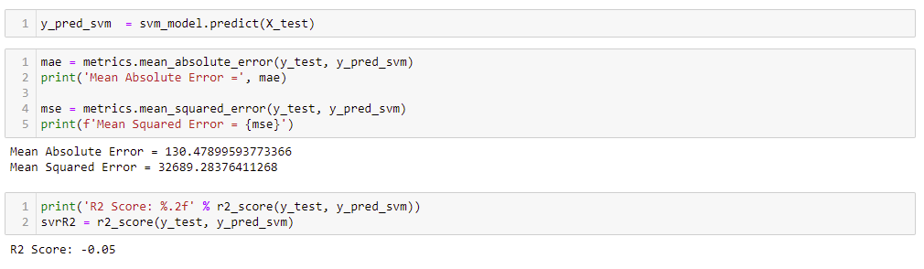
Build Machine learning models(SVR)

Slide 12
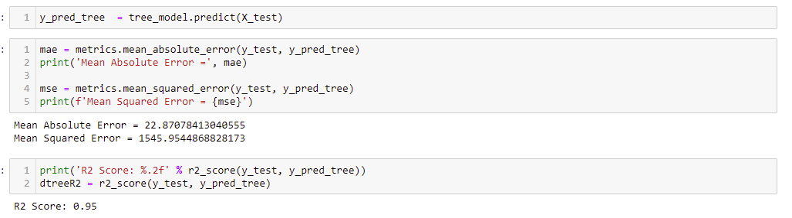
Build Machine learning models(Decision Tree)

Slide 13
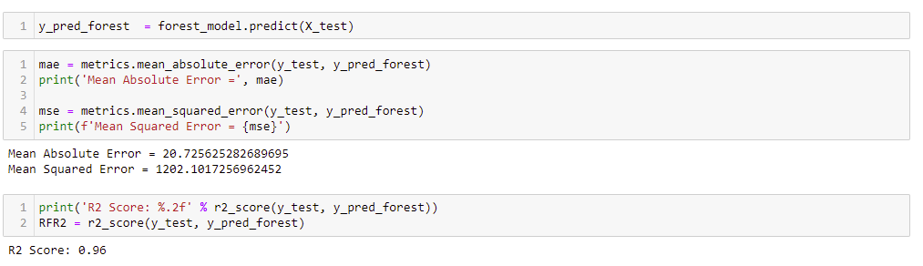
Build Machine learning models(Random Forest)

Slide 14
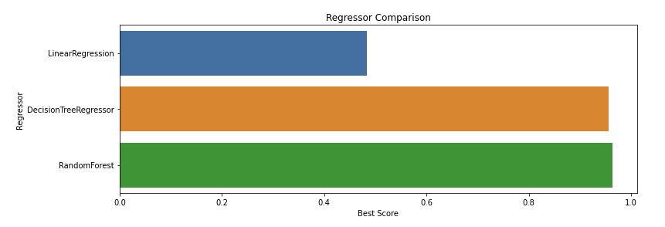
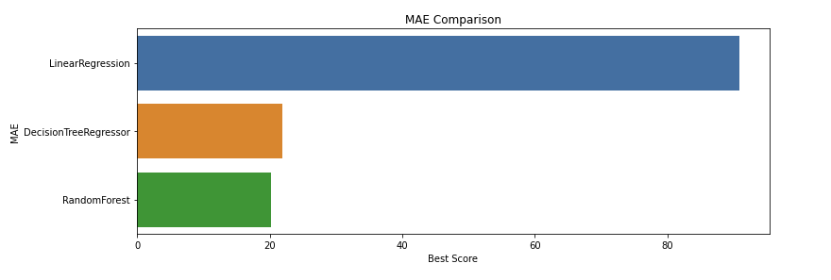
Comparing the models

Slide 15
Conclusion
1. From what we see of the heatmap, most of the factors do not have high correlation towards the reselling price
2. 2/3 of the models had high scores and the average predicted prices was about about 10% of the average price
3. Based on the R square score and MAE, Random forest gives the best result, but Decision Tree result is very similar and seeing as RF model is multiple Decision Tree, it is better to use Decision Tree model to save time .

